Slide 1


Getting Started With
Microsoft Access
Database
4
Manager of Information Center
Tendering Department
Arab Contractors
Said Fawzy

Slide 2
Getting Started With
Microsoft Access
Database
4
Logical Model
Manager of Information Center
Tendering Department
Arab Contractors
Said Fawzy

Slide 3
Contents
ERD Mapping to tables
create tables in MS access
Database Constraints

Slide 4



Slide 5
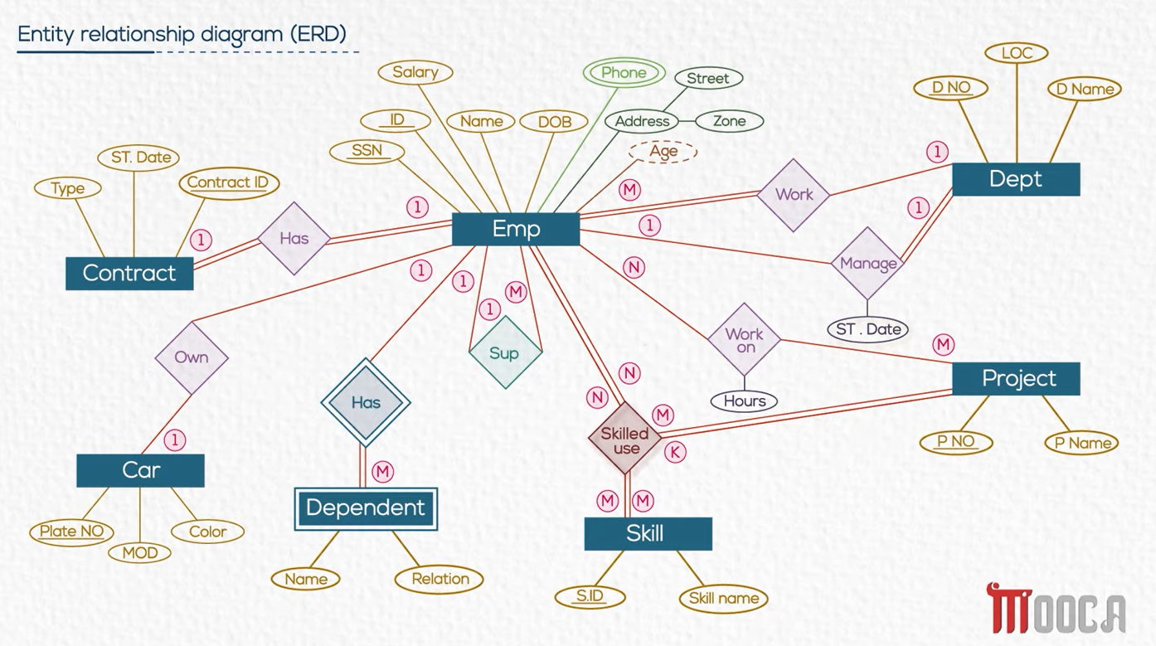


Slide 6
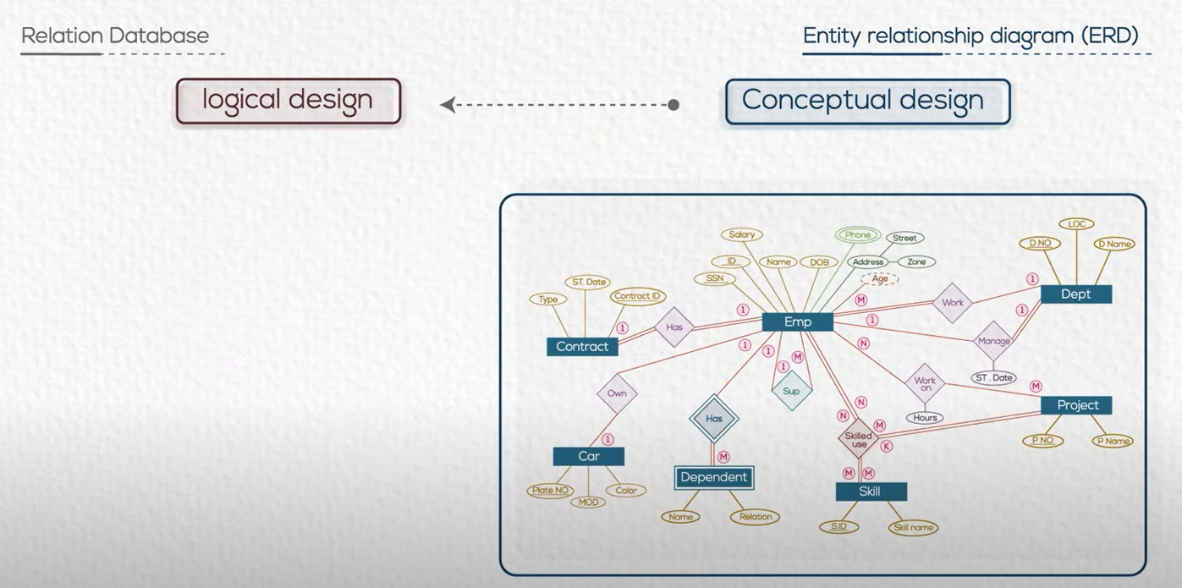

Slide 7
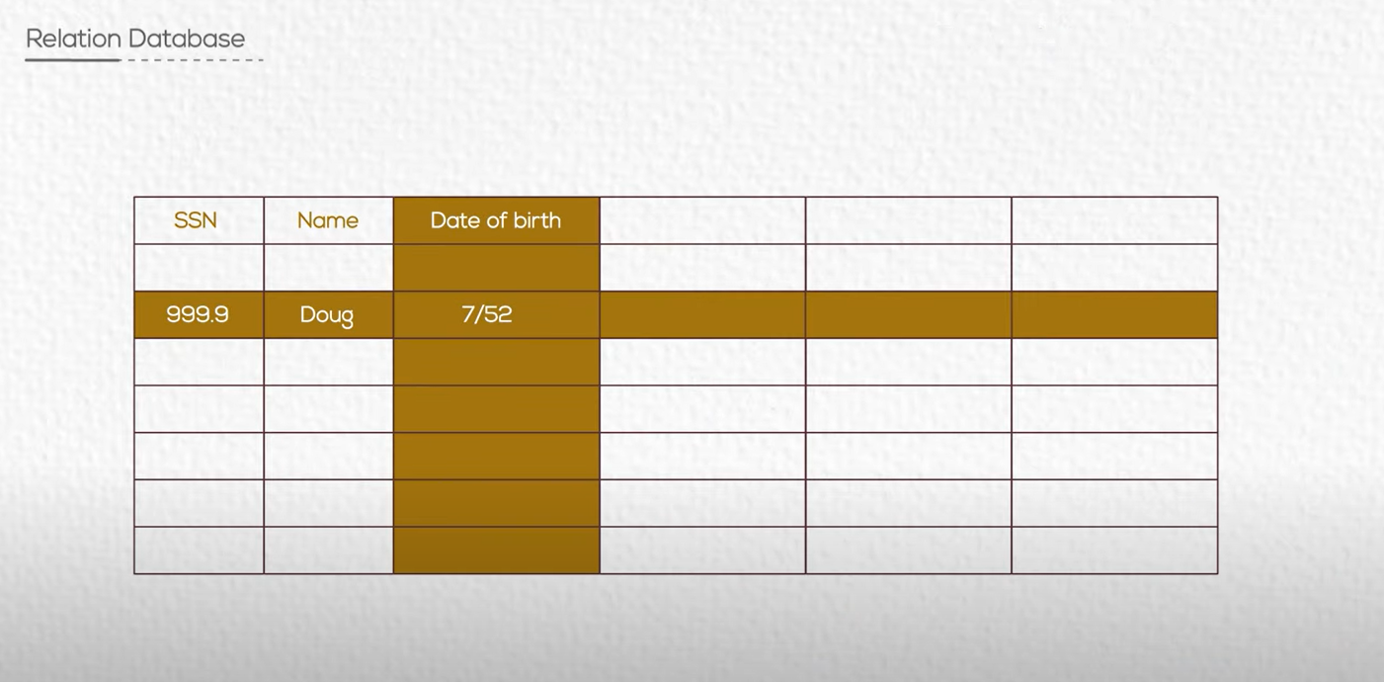
Relational DB is a group of tables

Slide 8
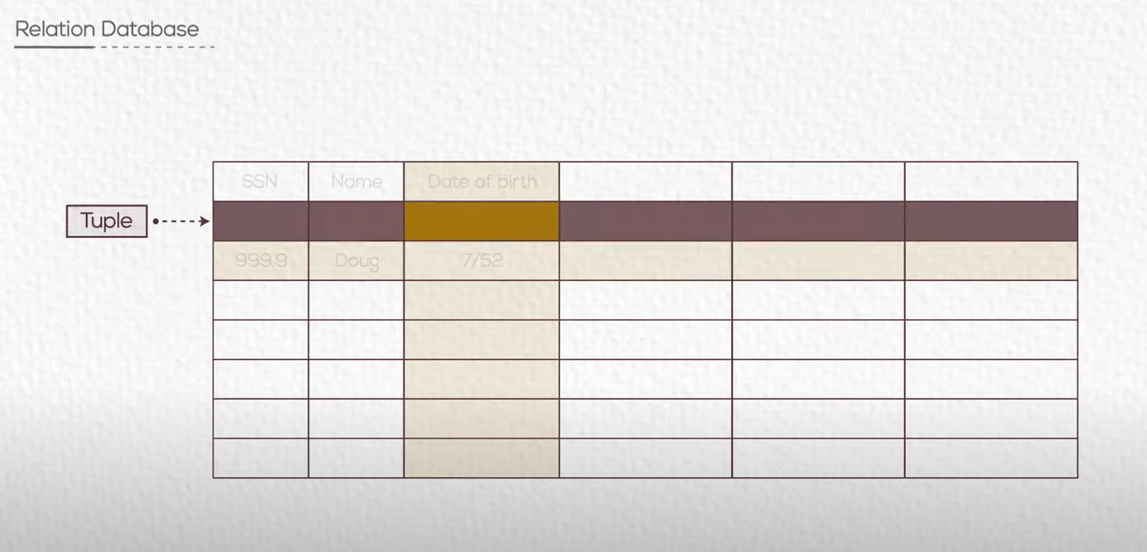


Slide 9
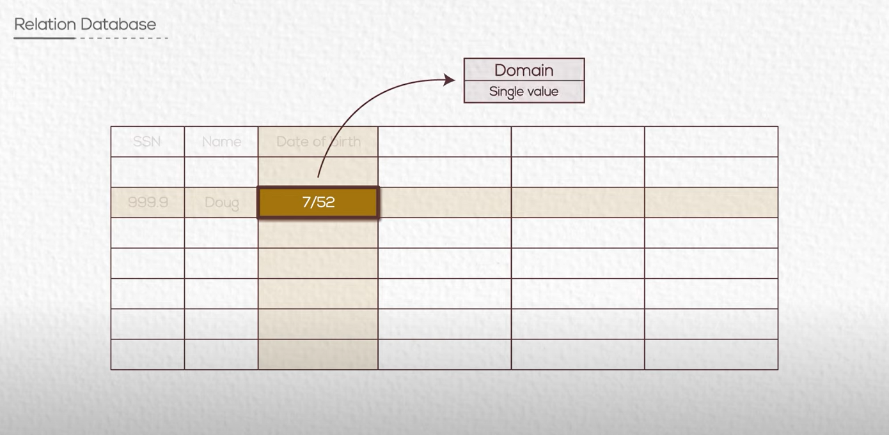

Slide 10
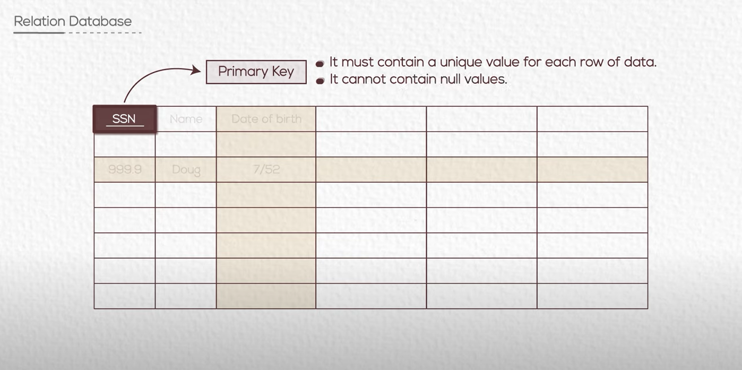

Slide 11
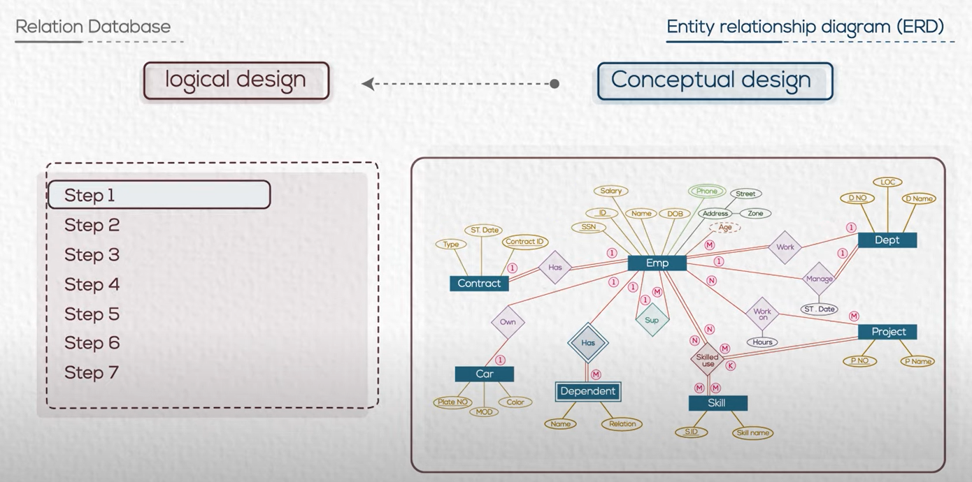
Follow some rules to convert to logical design

Slide 12

Task 5 : ERD Mapping to Tables
We need to convert our conceptual model into logical model

Slide 13
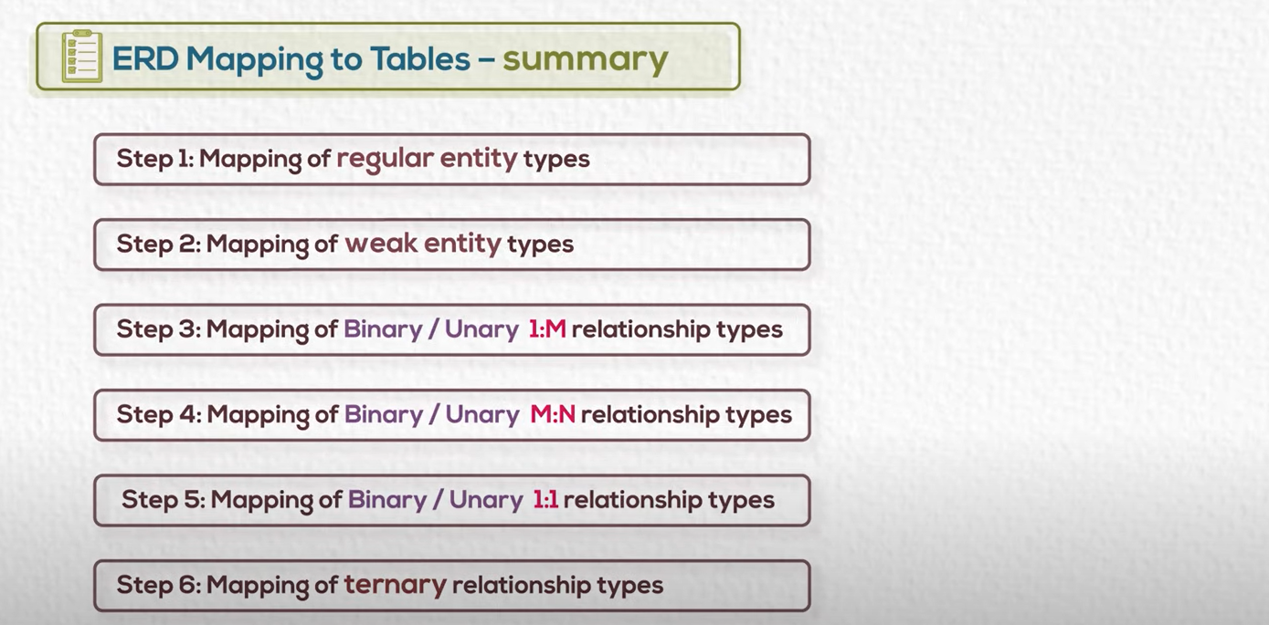

Slide 14
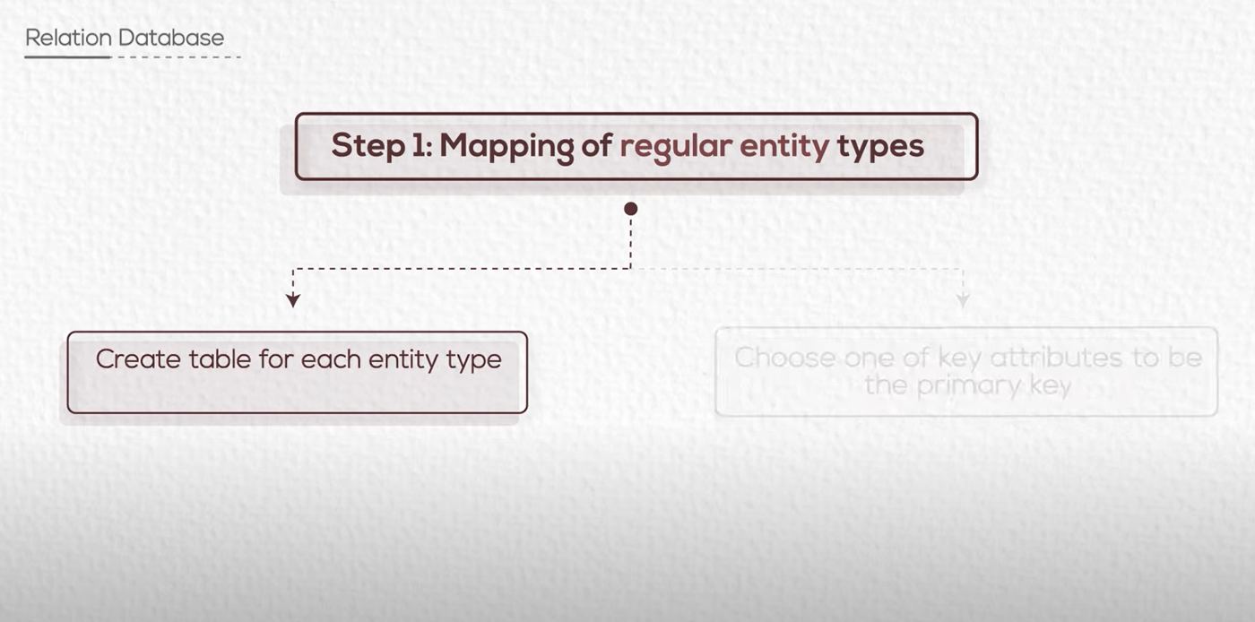

Slide 15
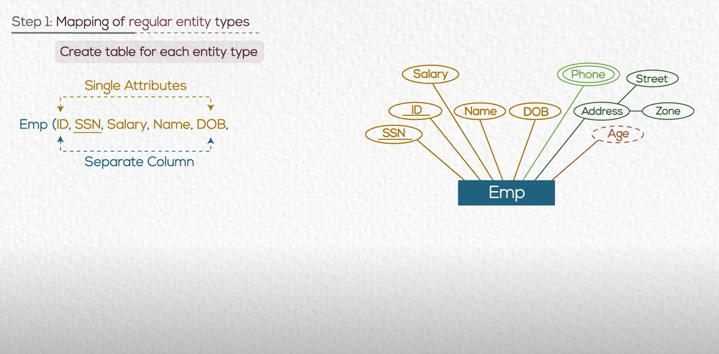
Single attribute map to one column

Slide 16
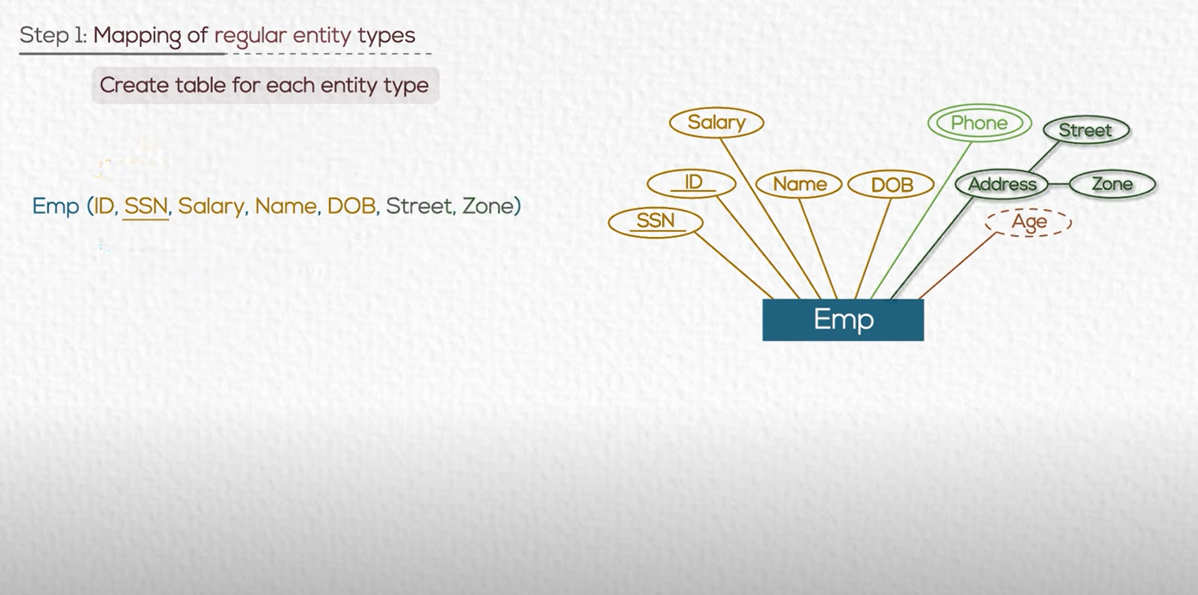
compost attribute map to columns for each

Slide 17
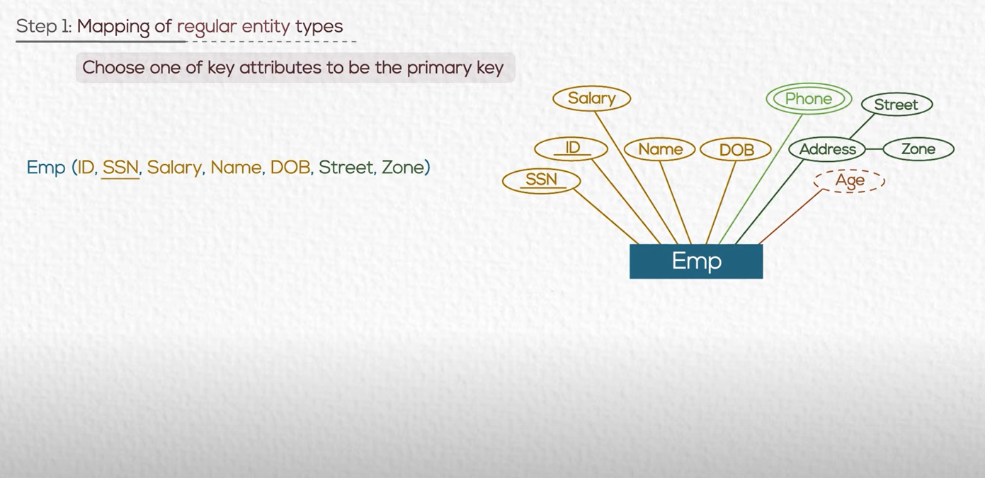

Slide 18
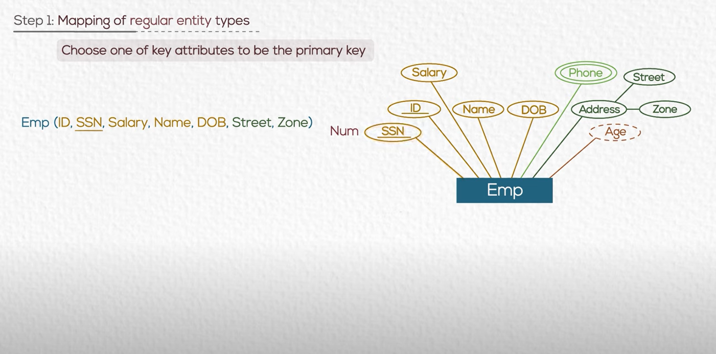
text
underline
We chose the less in storage if we have two candidates

Slide 19

Multi Valued attribute
Now we have problem for phone
As it is a Multi Valued Attribute

Slide 20
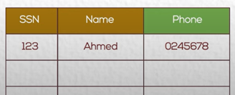
Multi Valued attribute
Ahmed has more than one phone
BUT …..Domain has only single value
What should we do ?

Slide 21
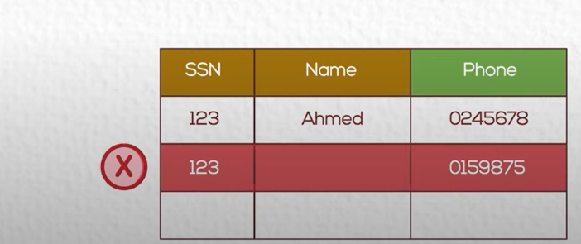
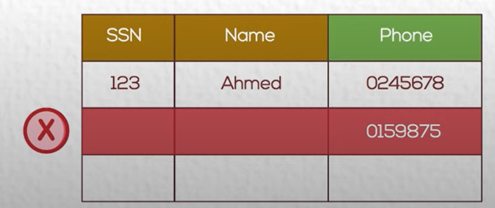
Multi Valued attribute
Breaking the rule of primary key.
No Duplicate
Breaking the rule of primary key.
PK can not be Null

Slide 22
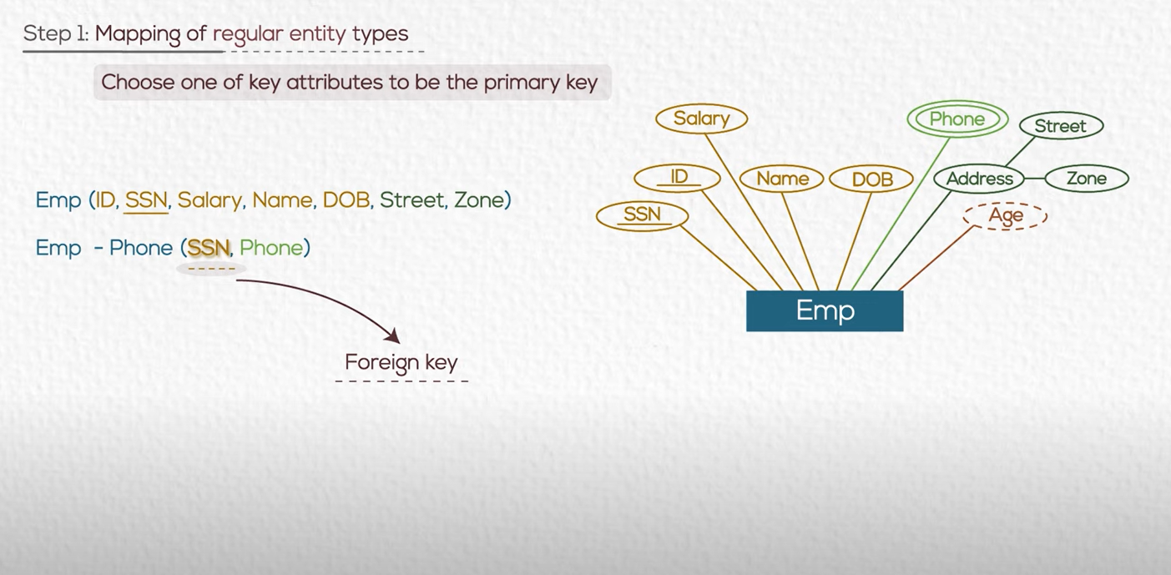
Solution :
Let Phones in separate table
Use a foreign key
A FK is a value reference PK in another table.
FK must have value in the main table as PK

Slide 23
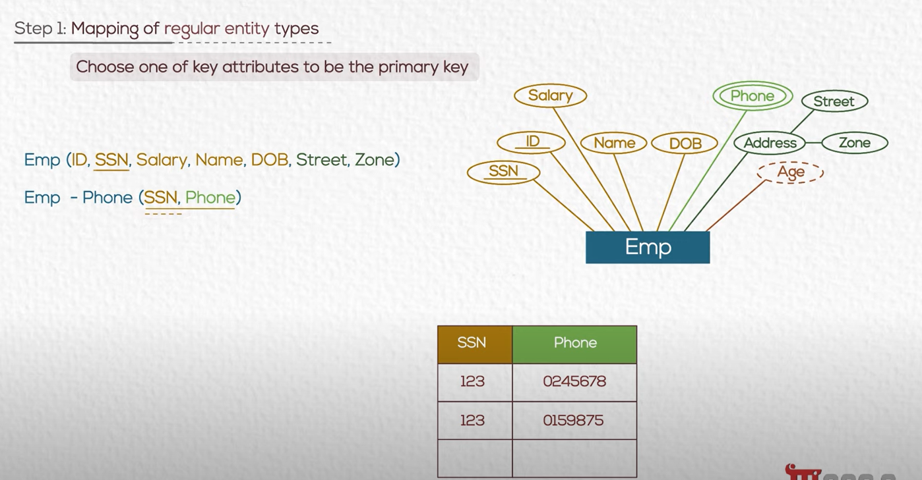
Solution :
PK of the Emp-Phone table is a composite Primary key (SSN , Phone)

Slide 24
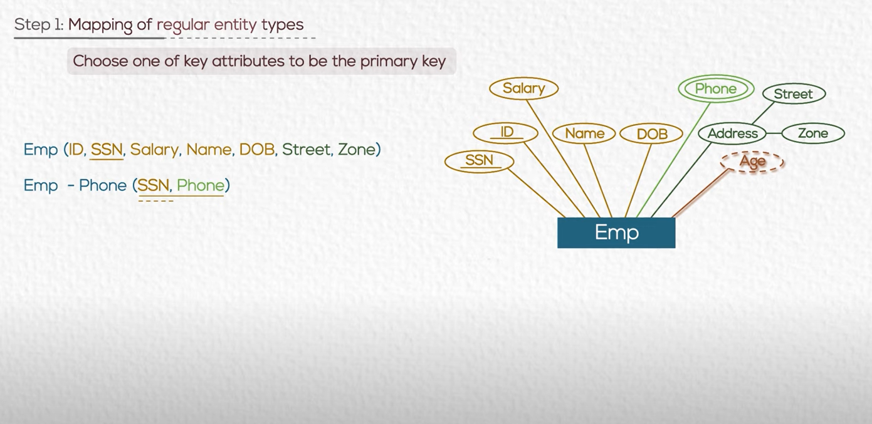
Derived attribute
We do not store value of Age as it is a calculated field.
It affects the performance of DB.
If we need it so much we can save it in a field.

Slide 25
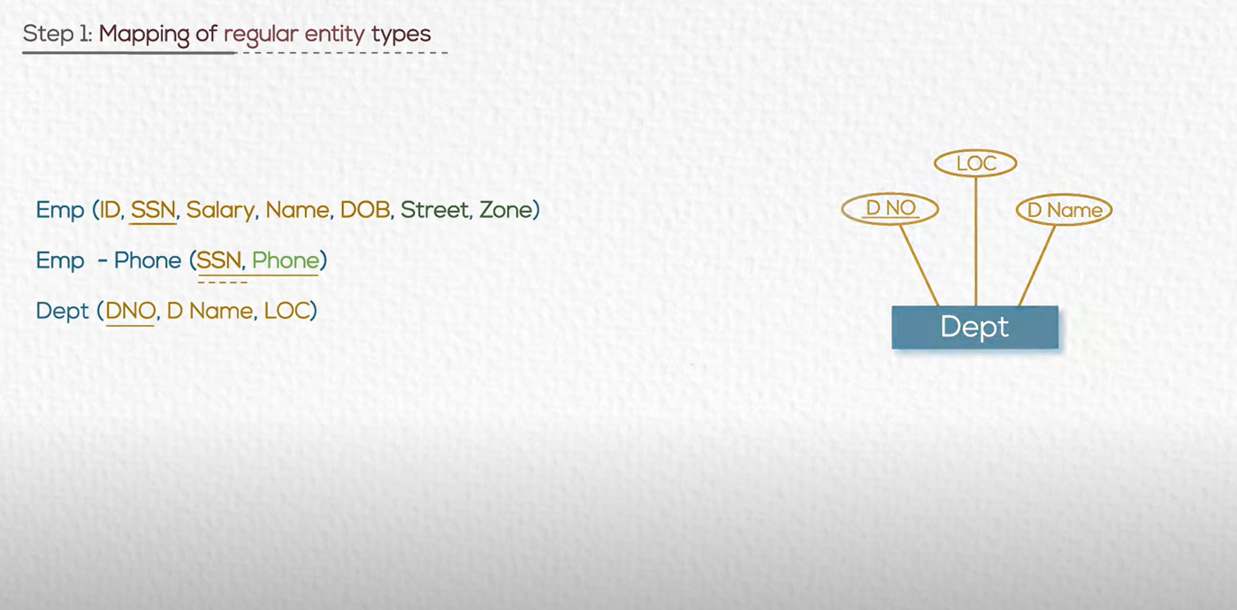

Slide 26
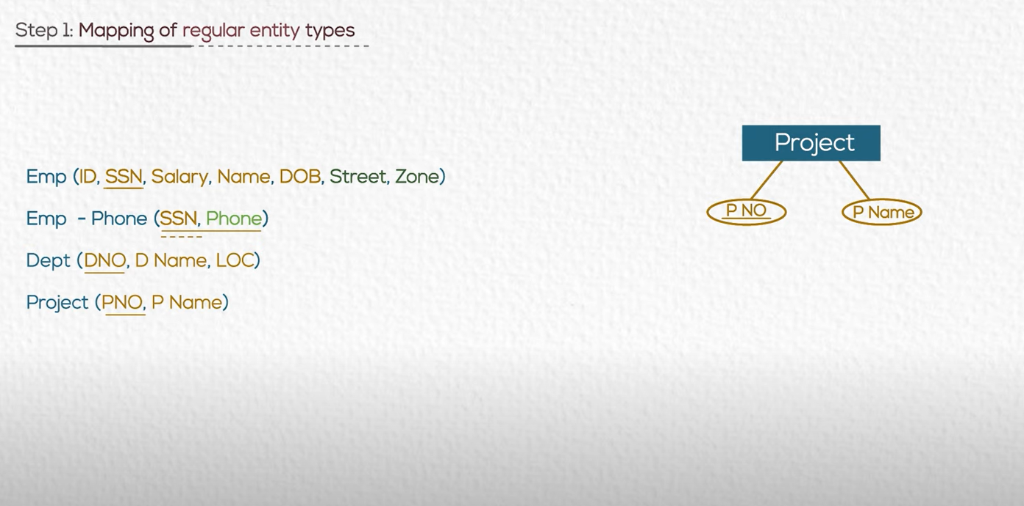

Slide 27
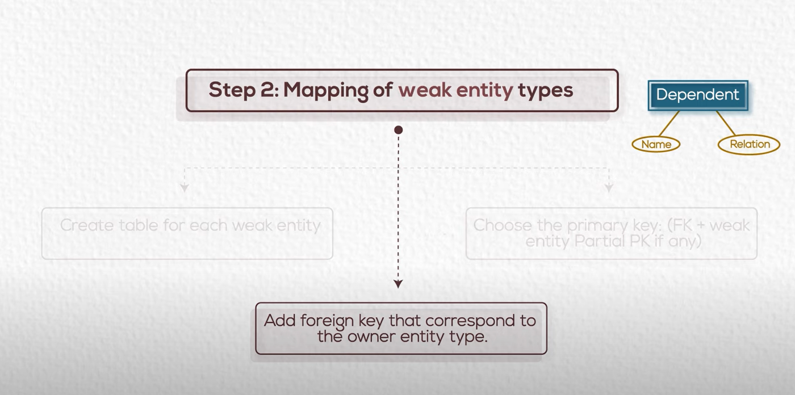

Slide 28
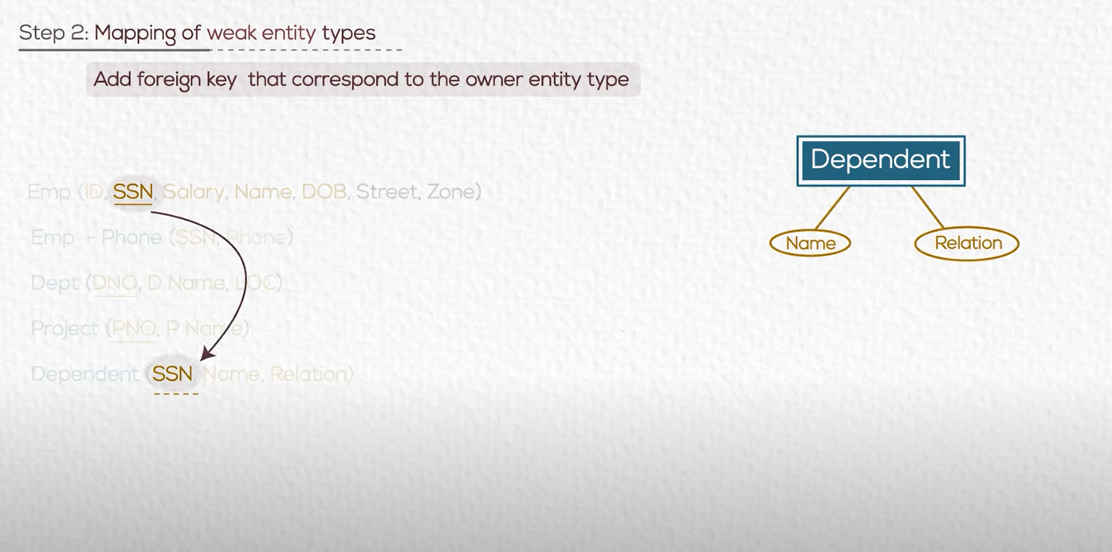
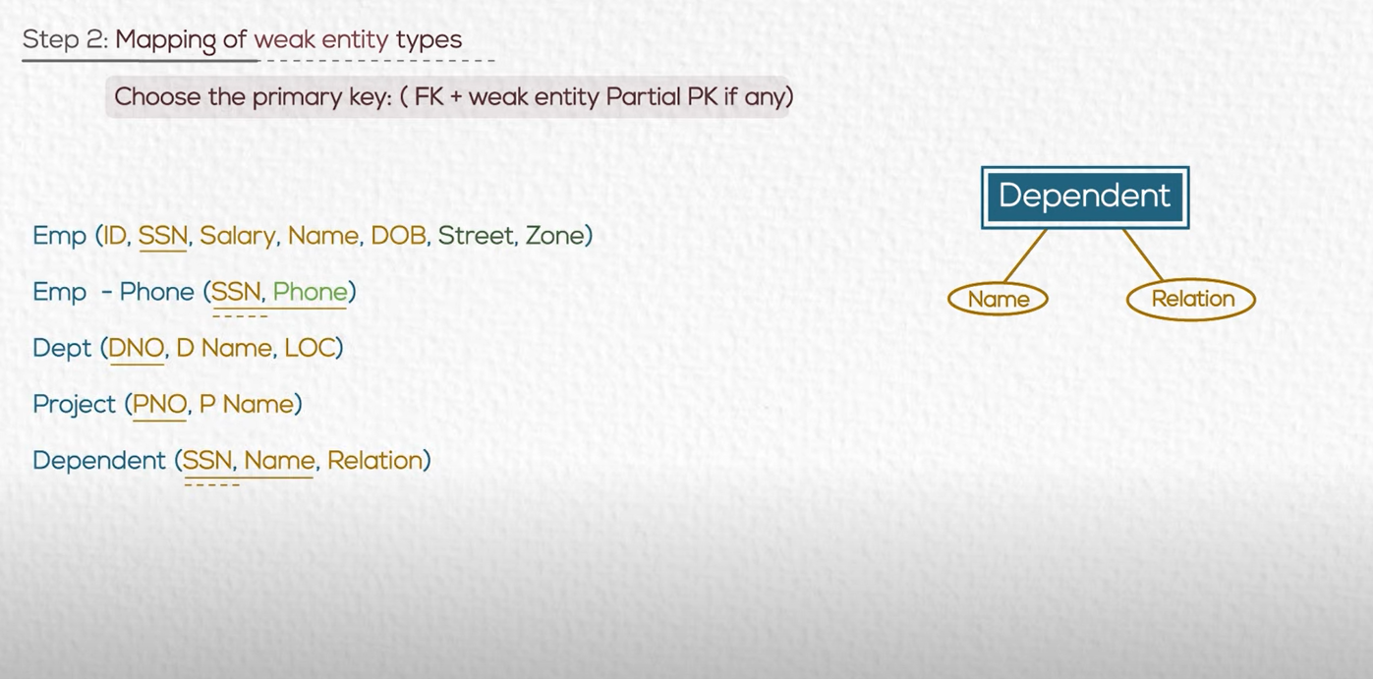

Slide 29
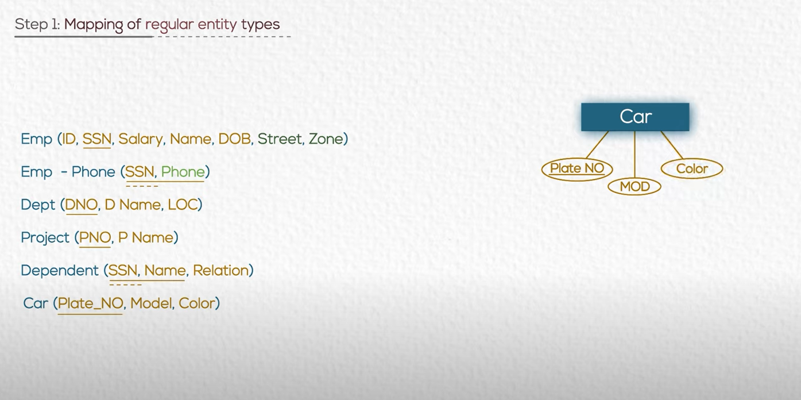

Slide 30
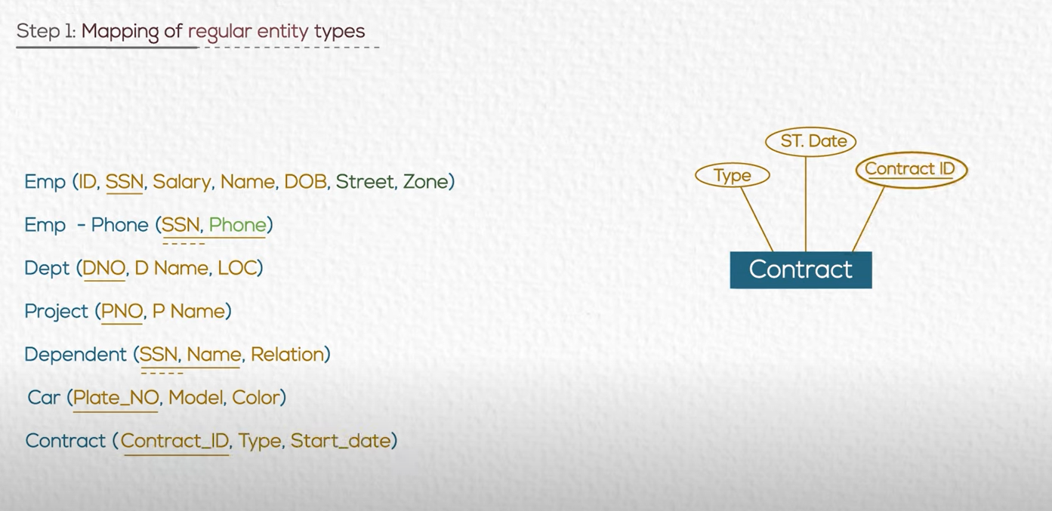

Slide 31
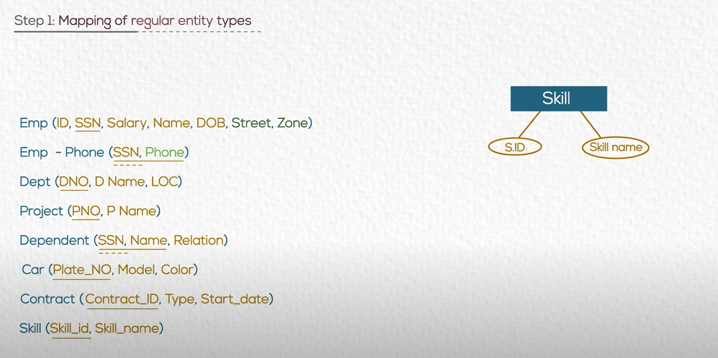

Slide 32



Slide 33
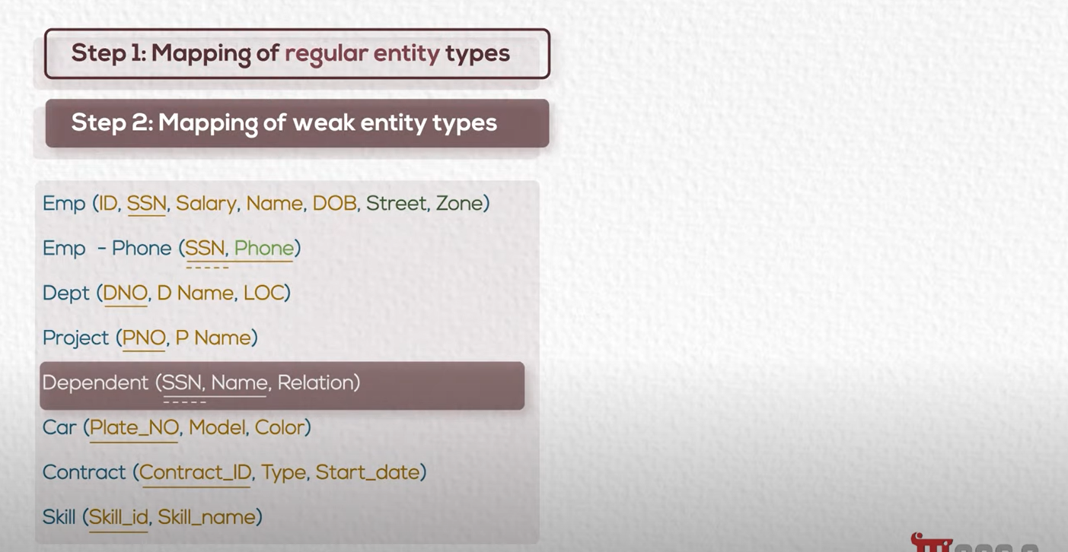

Slide 34
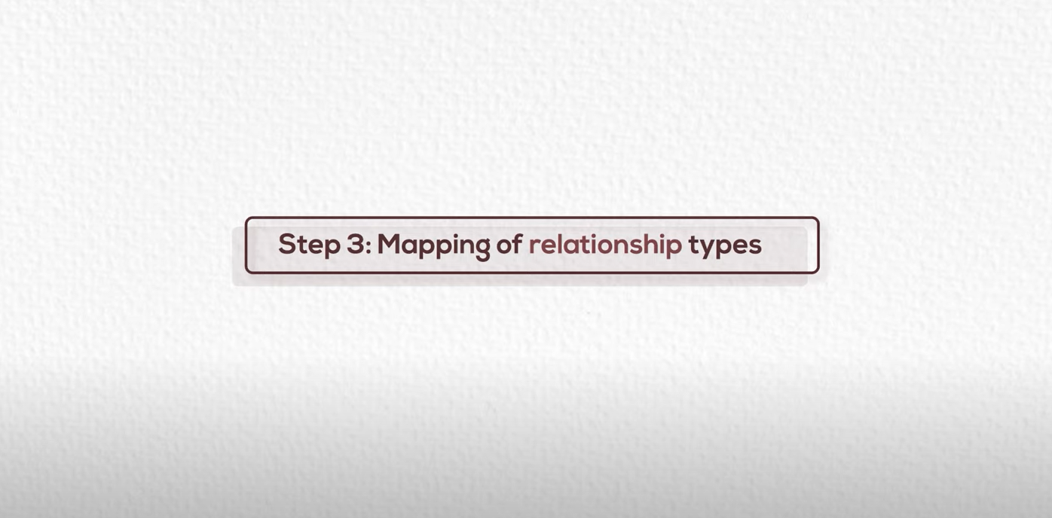

Slide 35
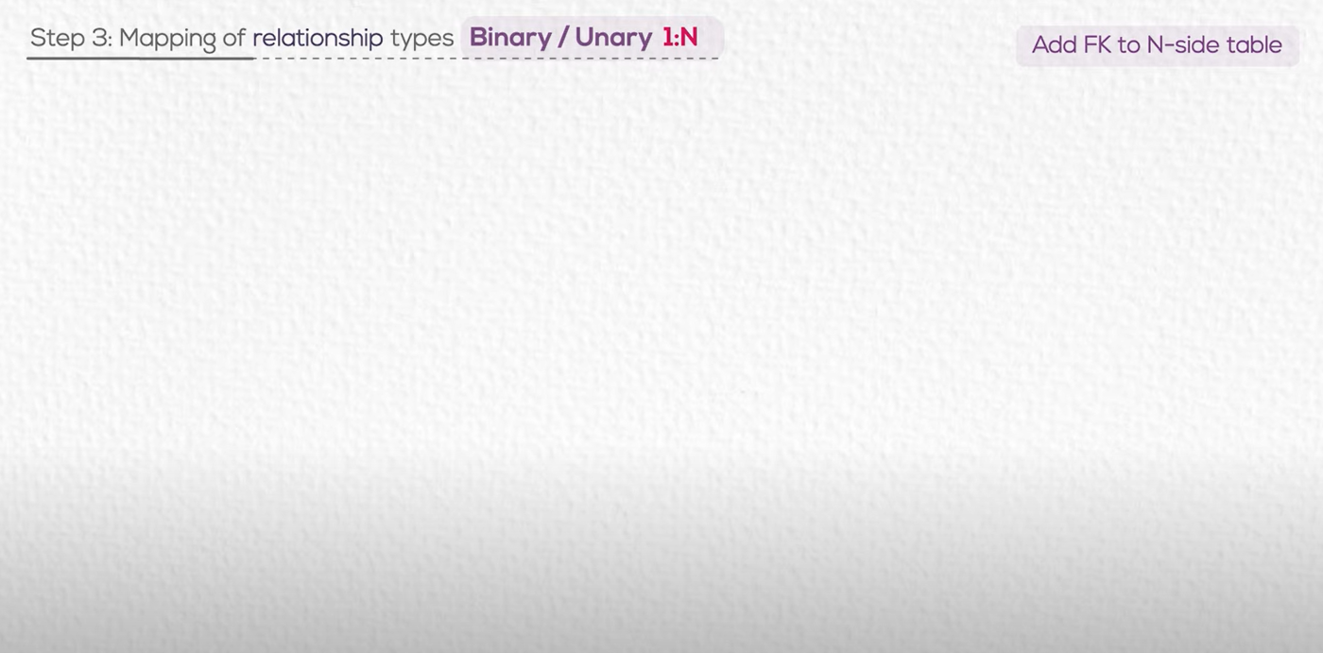

Slide 36
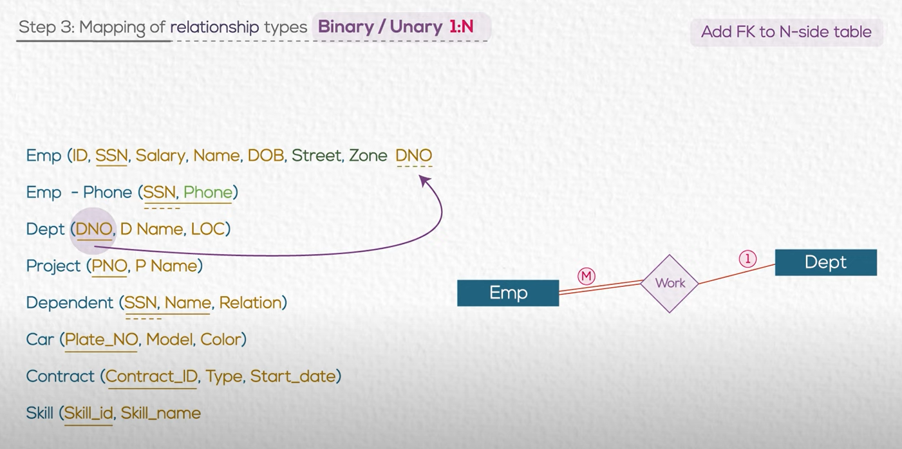

Slide 37
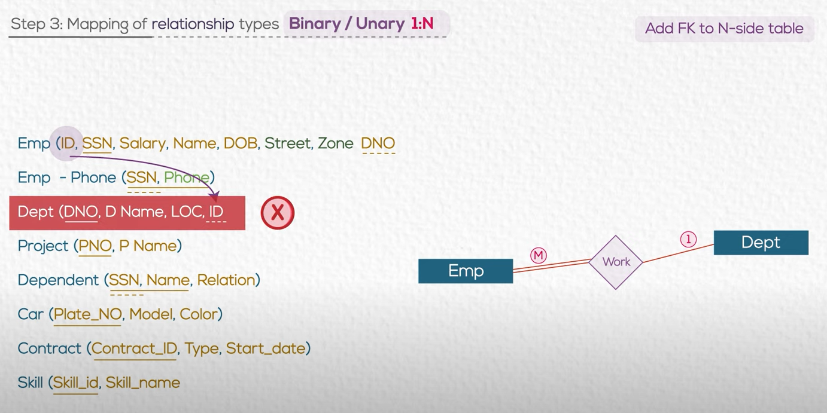
JUST TAKE CARE

Slide 38
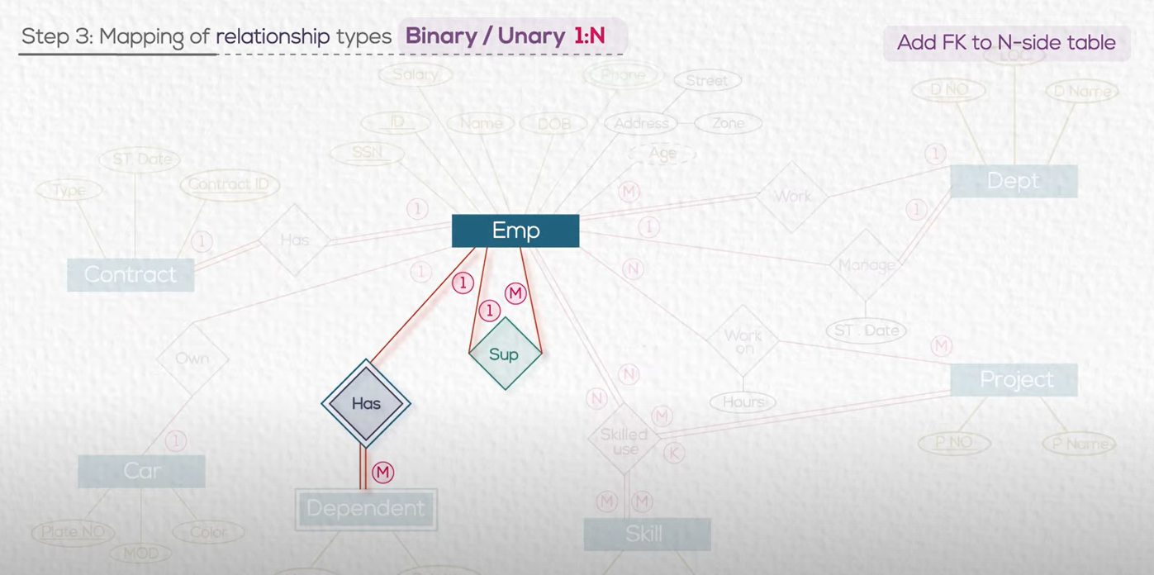

Slide 39
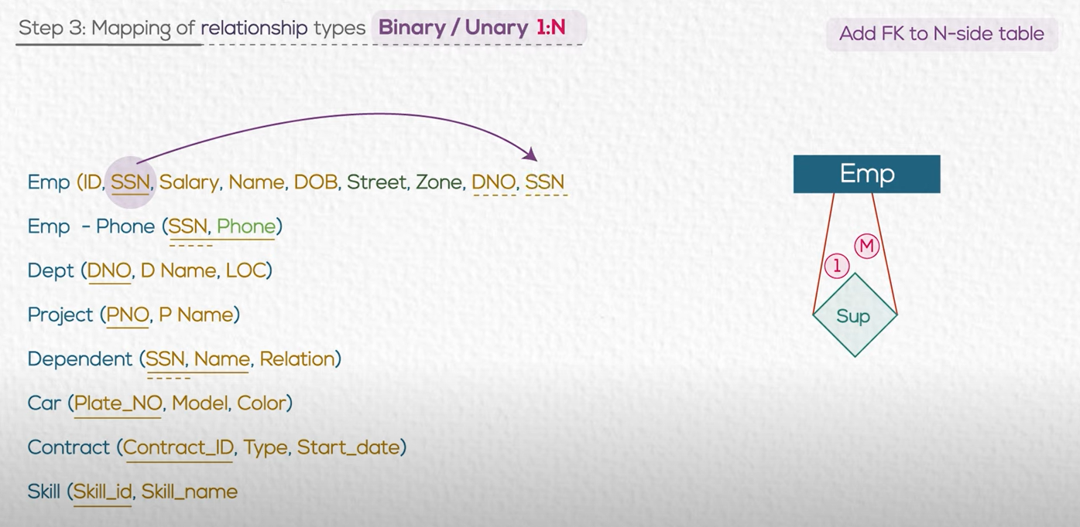

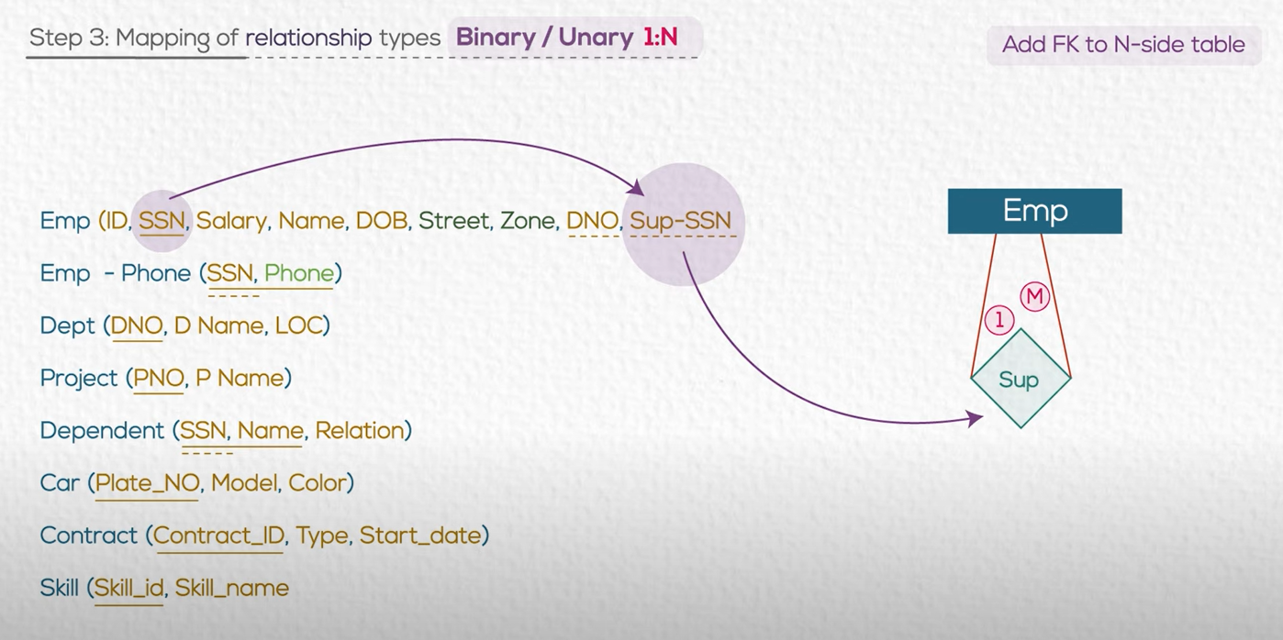

Slide 40
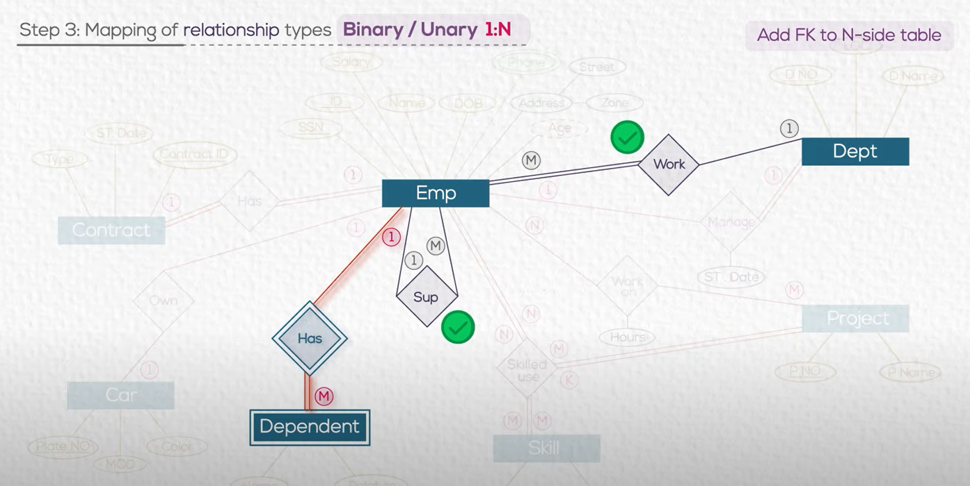

Slide 41
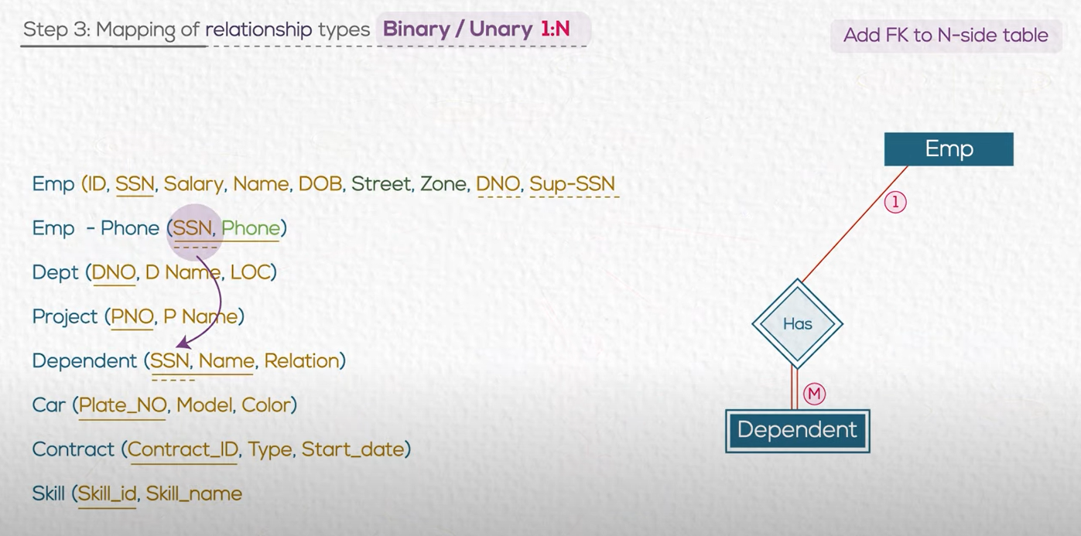
I have already did that

Slide 42

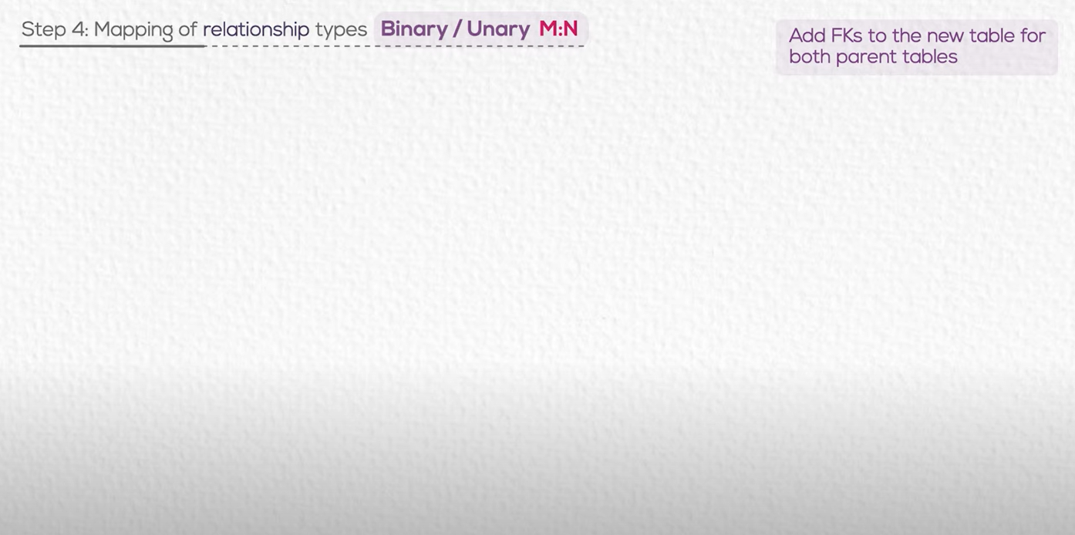

Slide 43
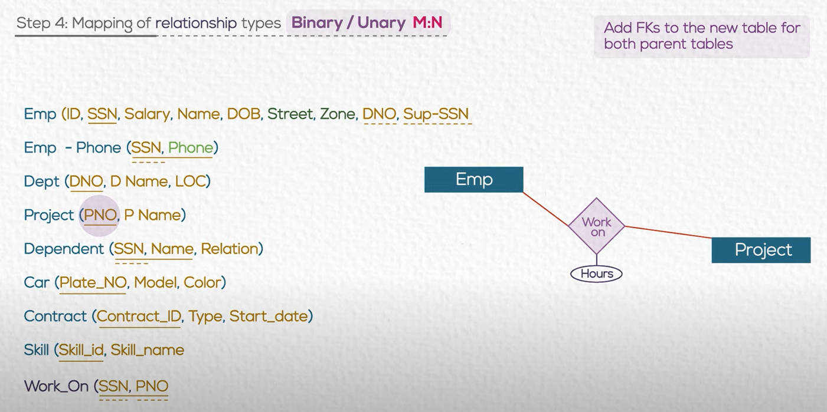

Slide 44
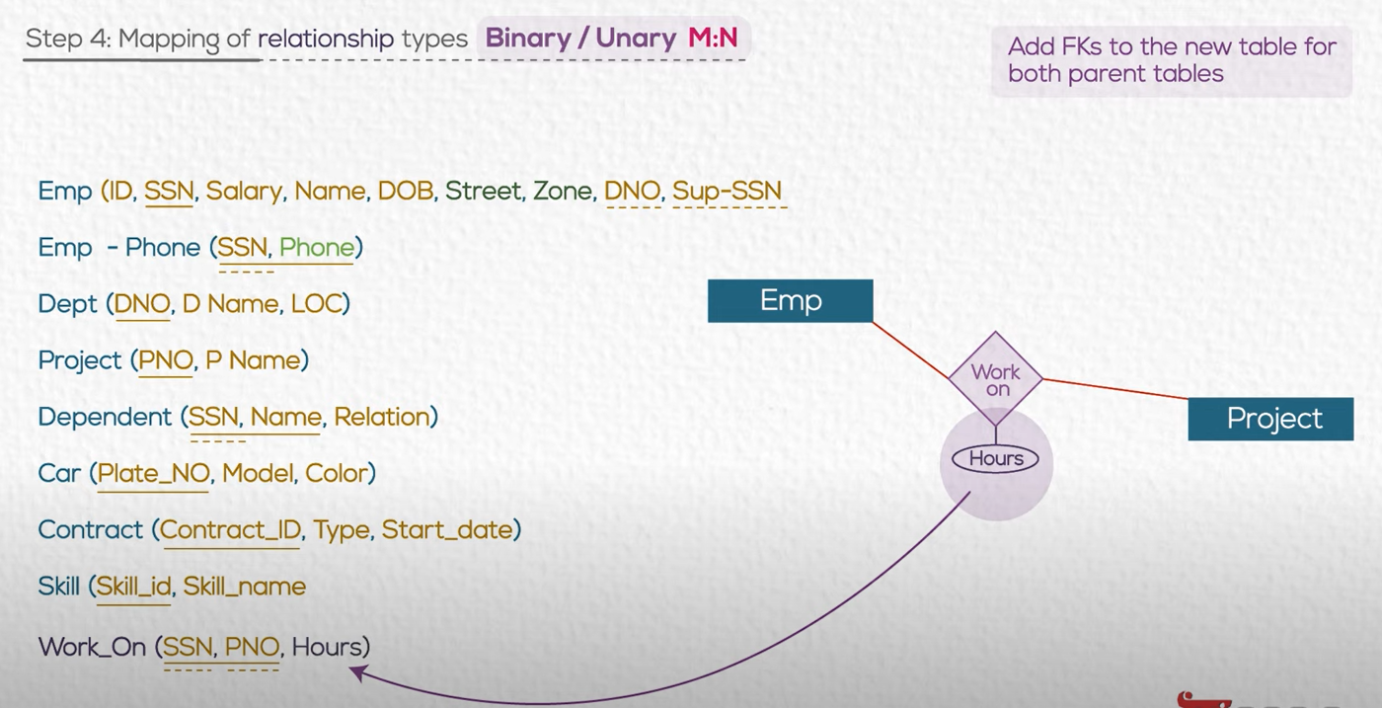
Attribute in the relation follow the foreign key

Slide 45
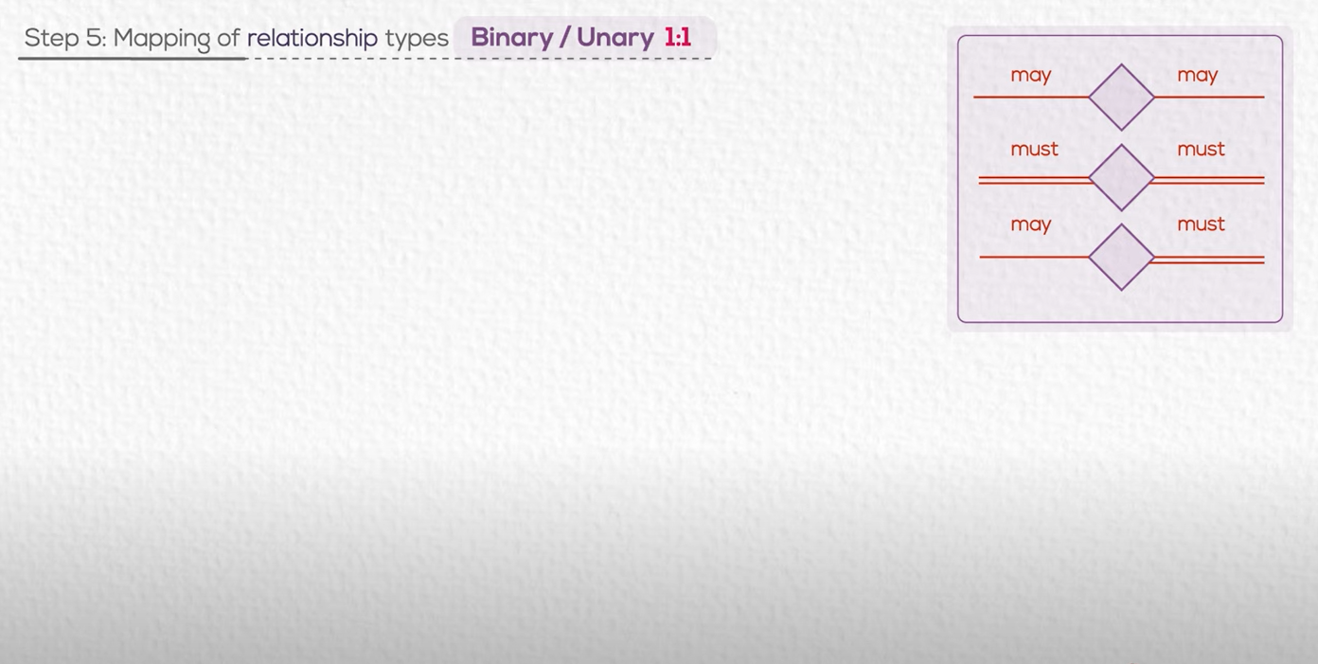

Slide 46
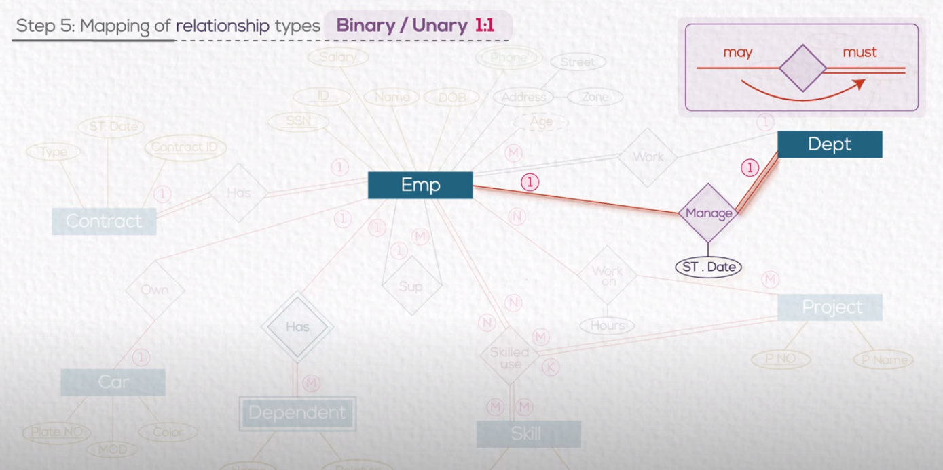
PK from MAY is FK in MUST

Slide 47
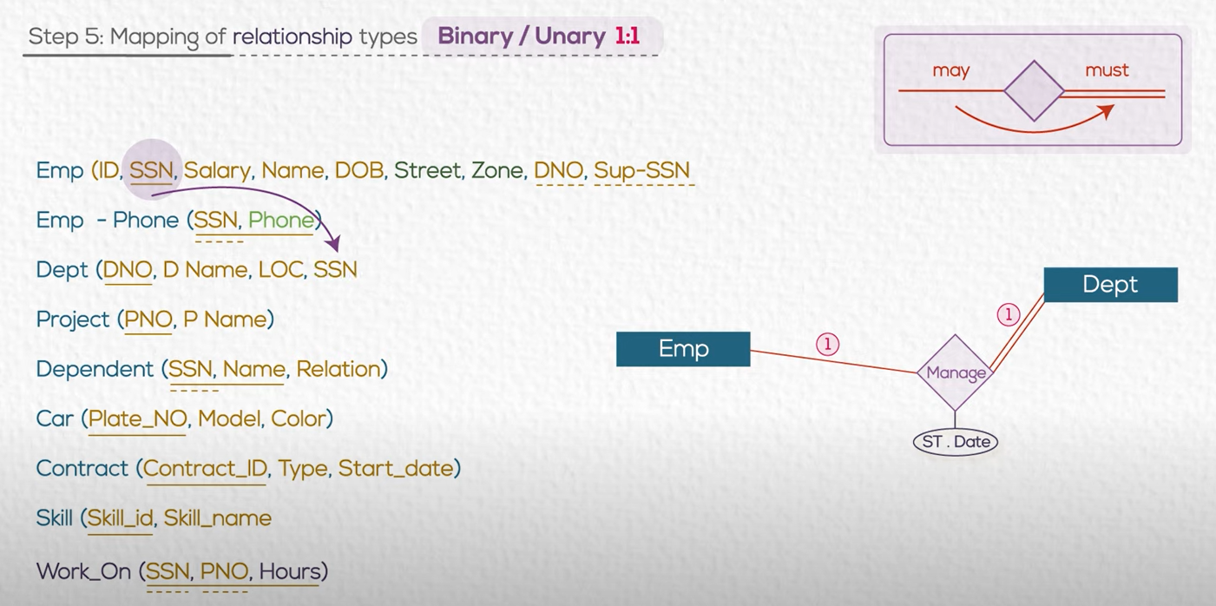
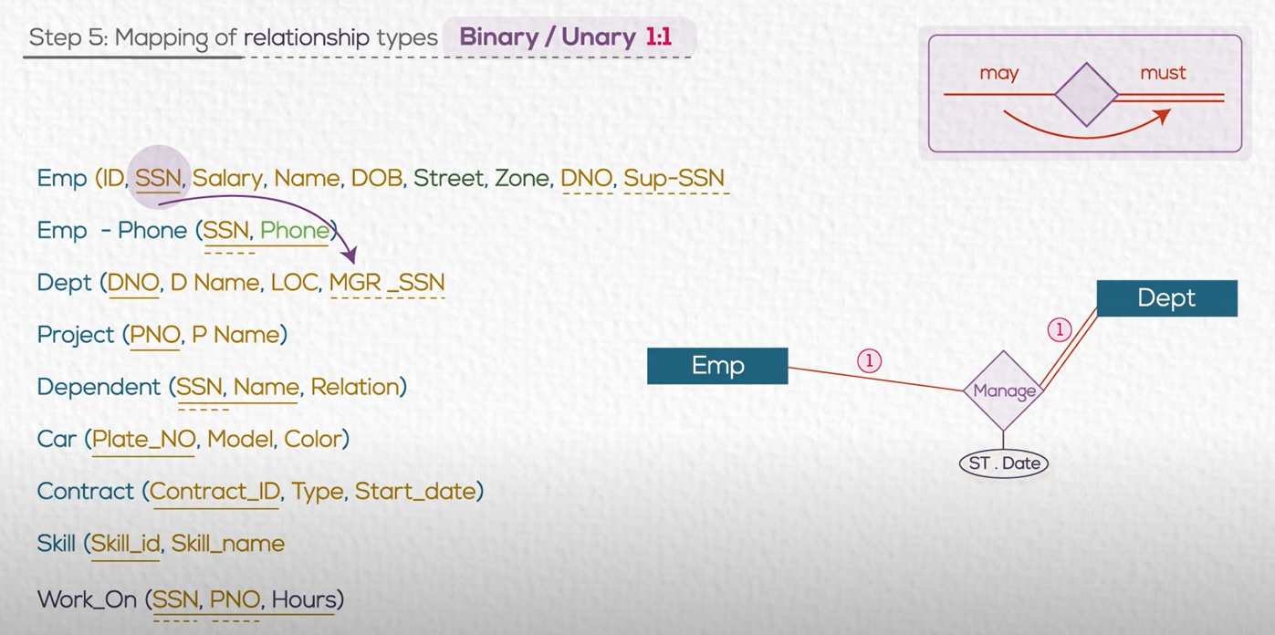

Slide 48
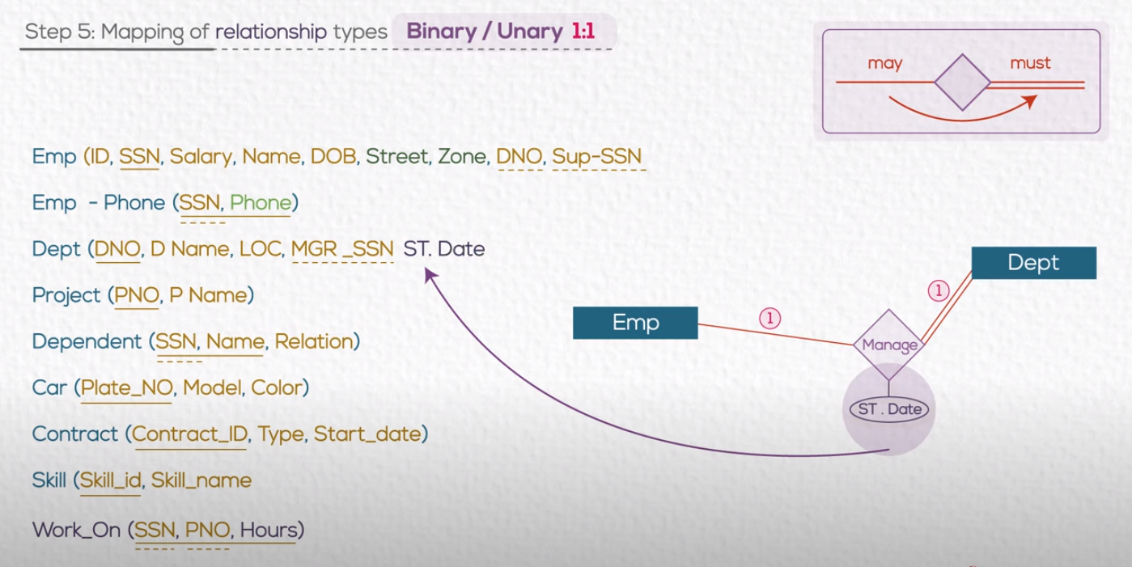
Remember : Attribute in the relation follow the foreign key

Slide 49
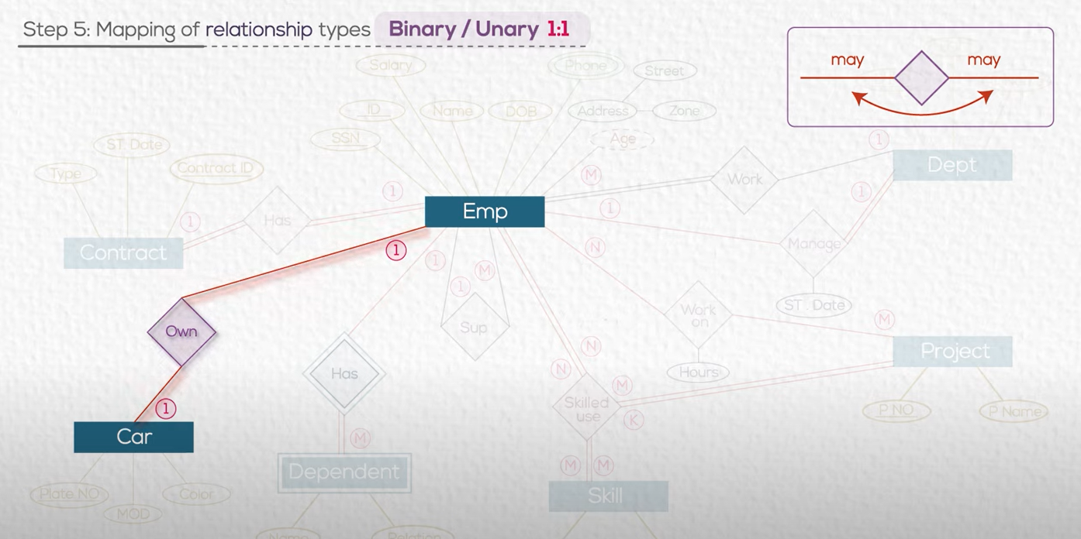
We have 3 options

Slide 50
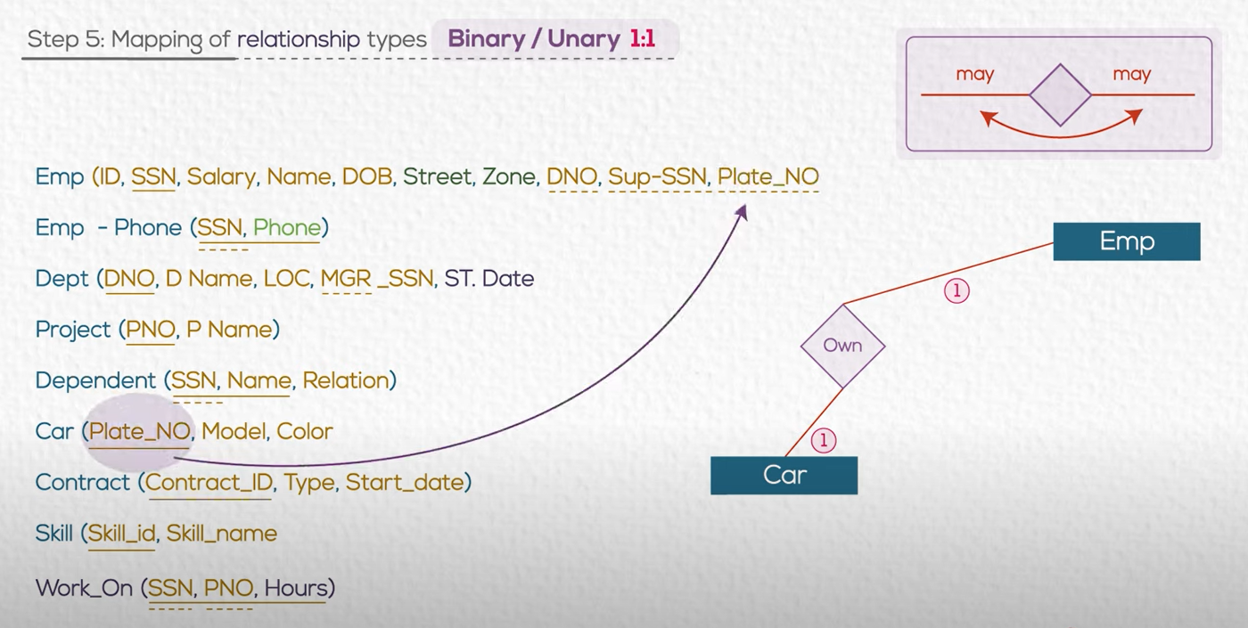
Solution 1

Slide 51
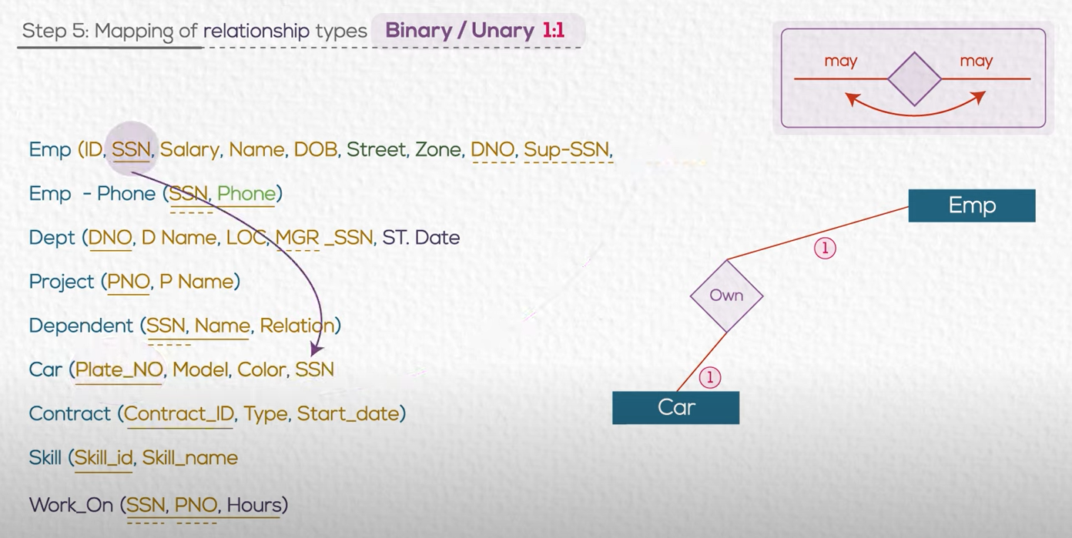
Solution 2

Slide 52
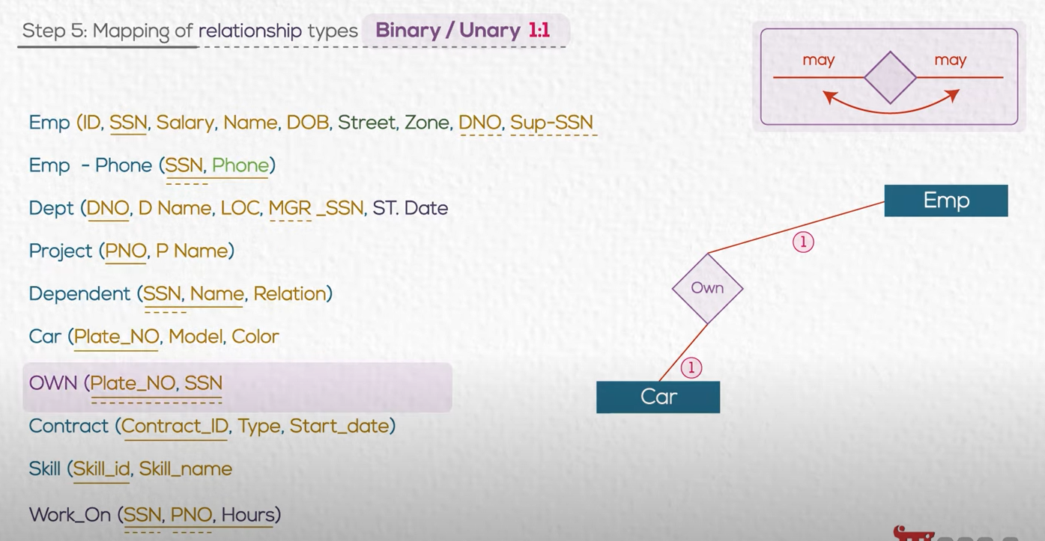
Solution 3

Slide 53

Recommended

Slide 54
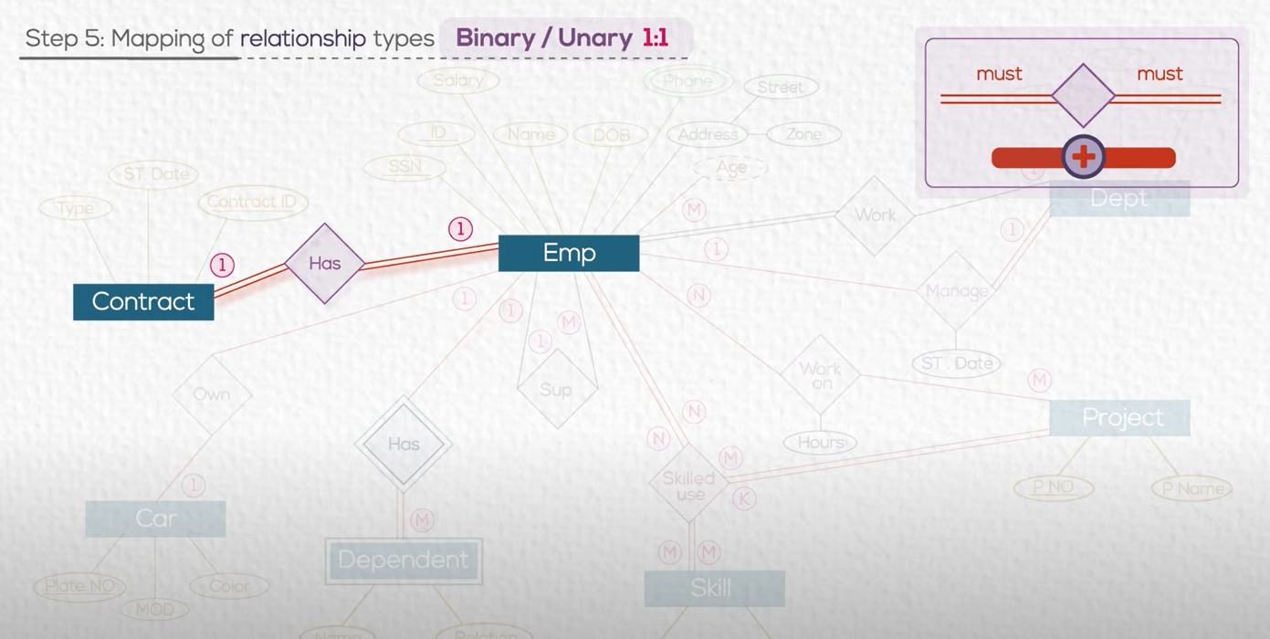

Slide 55

Solution : Merge the two tables

Slide 56


Slide 57

You can use any of the PK of the two tables as PK for the new merged one

Slide 58


Slide 59

Create new table

Slide 60

Add FKs to the new tables for all parent tables.

Slide 61


Slide 62
Summary

Slide 64

Simple(single) attributes.

Slide 65


Slide 66


Slide 67


Slide 68


Slide 69


Slide 70


Slide 71

1:M

Slide 72


Slide 73


Slide 74

We check the participation

Slide 75


Slide 76

Attributes on relations always follow the FK

Slide 77

Relationship Diagram

Slide 78




Slide 82



Slide 84
Relationship Diagram

Slide 85
Activity 3: ERD to Tables
• Use your conceptual model in activity to and convert them into tables

Slide 87






Slide 88


Slide 89


Slide 90


Slide 91


Slide 92





Slide 93


Slide 94

Referential Integrity works when insert or delete

Slide 95

We insert first a parent record then the child one : (we have dept with ID=100 and then we say the employee is in Dept 100)

Slide 96

FK works as a pointer to its parent

Slide 97

If you want to delete parent (department),
You must first delete children (records for its employees)

Slide 98


Slide 99



Said Fawzy

